Slide 1
To study the effect of enzyme lactase on milk

Slide 2
Experiment details:
What are enzymes?
How do they play role in our body?
What is lock and key model of enzyme catalysis or specificity.
Denaturation of enzyme under different conditions and its effect on its activity.

Slide 3
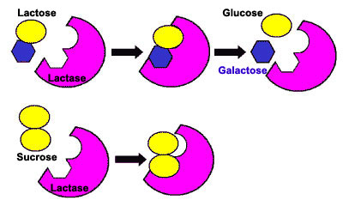
Substrate specificity – The active site of an enzyme is very specific to its substrates as it has a very precise shape. This results in enzymes being able to catalyze only certain reactions as only a small number of substrates fit in the active site. This is called enzyme-substrate specificity. For a substrate to bind to the active site of an enzyme it must fit in the active site and be chemically attracted to it. This makes the enzyme very specific to its substrate. The enzyme-substrate complex can be compared to a lock and key, where the enzyme is the lock and the substrate is the key.

Slide 4
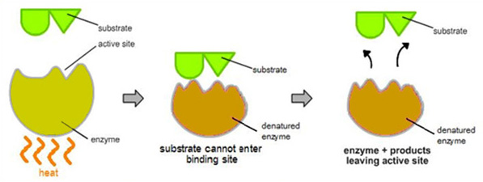
Denaturation is a structural change in a enzyme/protein that results in the loss (usually permanent) of its biological properties. Refers to temperature and pH change. Enzymes usually have an optimum temperature and pH requirement at which they work most efficiently. As temp and pH diverges from optimum level, enzymatic activity decreases. Both acid and alkali conditions can denature enzymes. The optimum temperature for lactase is about 25 °C & pH of 6 for its activity.

Slide 5
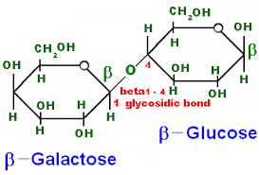
Lactose:
Lactose:
It is a milk sugar
Disaccharide
Composed of glucose and galactose

Slide 6
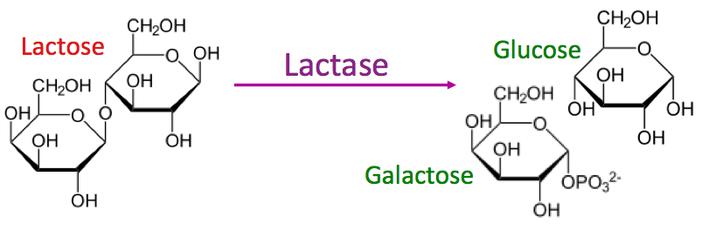
Lactase:Enzyme
Lactase
enzyme produced by many organisms.
It is located in the brush border of the small intestine of humans and other mammals.
Lactase is essential to the complete digestion of whole milk; it breaks down lactose, a sugar which gives milk its sweetness.

Slide 7
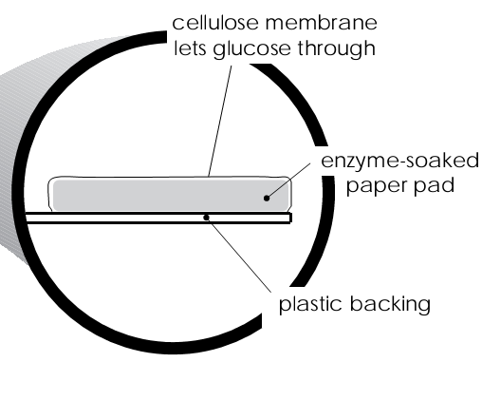
what's on the strip ……………..
Three components are immobilized on the strip
Glucose oxidase
Horse radish peroxidase
Potassium iodide (KI)

Slide 8
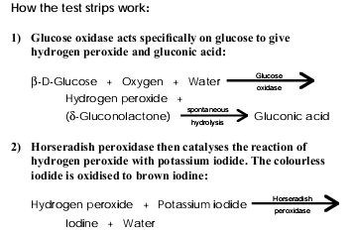

Slide 9
Function of strip
All of these tests utilise the enzymes glucose oxidase and peroxidase, immobilised on a paper pad at the tip of the strip.
The pad is covered with a thin cellulose membrane which is permeable only to small molecules such as glucose.
In the presence of oxygen and glucose, the products of the enzyme react with a chemical (potassium iodide immobilized on the paper pad) to produce a colour change.
The intensity of the colour which develops indicates the glucose concentration.
The principles behind these diagnostics are readily demonstrated, using potassium iodide as the chromagen (colour-change reagent).

